Slide 1

Part II
Analyze Users

Slide 2
Instructions
Install jupyter notebook anaconda
Open the notebook after downloading it, via jupyter menu finding it in the place is saved
Download the dataset and store it in the same place with the notebook
Run the notebook

Slide 3
Customer Segmentation
Cluster | Customer Attributes
0 | These customers are seen making orders often. The order value is high and goes to 72 euros , indicating that they spend a lot when shopping . This could mean that users in this segment are likely to make multiple purchases in a single order.
1 | Customers in this segment have low frequency (1,8), and order value(9,9 euros) scores. These are people who make occasional purchases.
2 | Customers in this segment have been seen making purchases very frequently(6,7). This could mean several things as for example they were disappointed with the service and switched to a competitor platform or they no longer have any interest in the products sold.
3 | This cluster consists of users with the highest frequency(31,1) and order value (143,7 euros) and should be taken into account that these are our stable and regular clients. This could mean that users in this segment are likely to make multiple purchases in a single order.

Slide 4
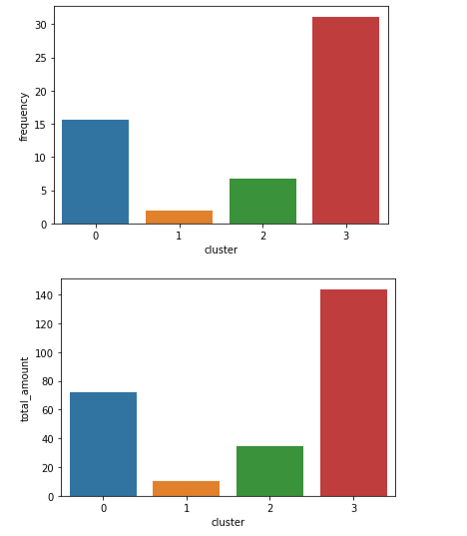
Customer Segmentation (plots)

Slide 5
Conclusions
The conclusion is to target to the cluster 2 (team 2) in order to motivate these customers to order more frequently and to spend more money when ordering. So, the Marketing department should target this team in order to engage it in breakfast orders and to gain more value from these users.

